Slide 1
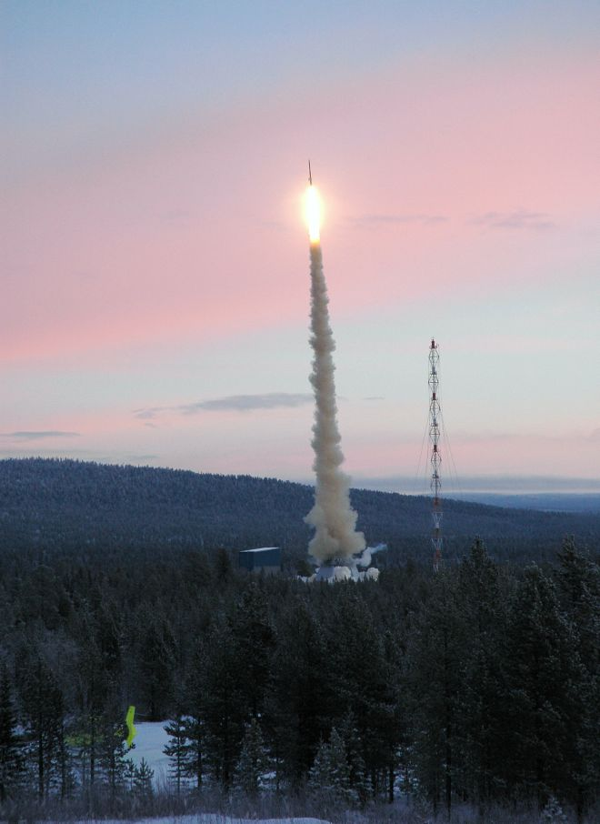
Surface Tension and Viscosity of
Ni-Al Catalytic Precursor Alloys
R. K. Wunderlich and H. -J.Fecht
University of Ulm, Institute for Micro and Nanomaterials, Ulm, Germany
Contact: rainer.wunderlich@uni-ulm.de
Start of a TEXUS sounding rocket with
an electromagnetic levitator payload

Slide 2
Outline
Introduction & Motivation
Technical aspects
Results

Slide 3
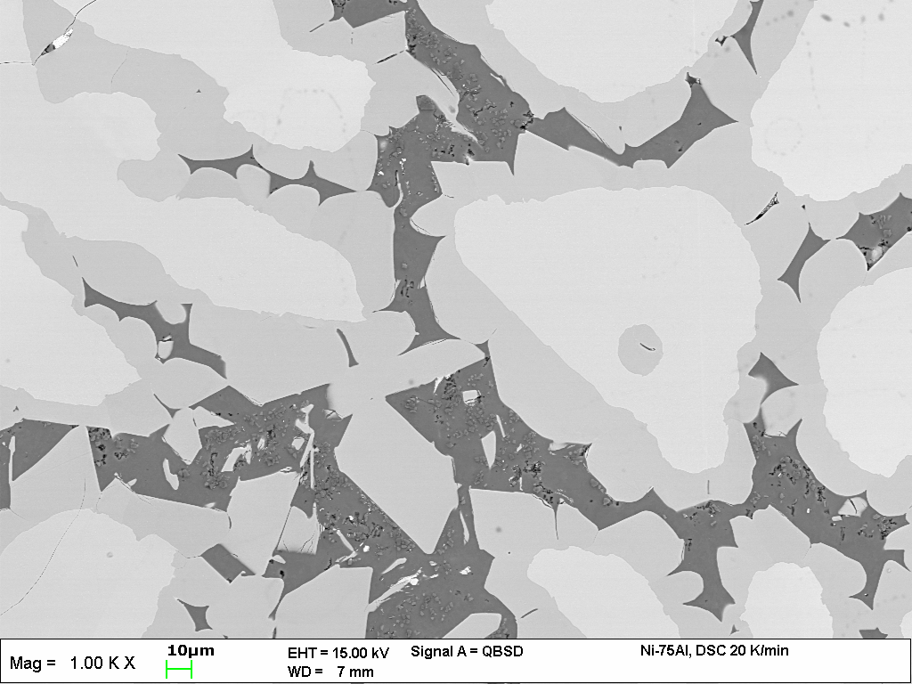
Motivation - 1
Nanocrystalline catalytic Ni powders are produced by
leaching various Al-rich Ni-Al precursor alloys (Raney-NiAl)
- The Al₃Ni phase is transformed into nc - Ni
The Catalytic efficiency of the final material depends very much
on the microstructure & phase composition of the Ni-Al precursor
alloy.
Cooled in HTDSC, R_{C} =0.33 K/s
Al₃Ni₂
Al₃Ni
Al + Al₃Ni
20 μm

Slide 4
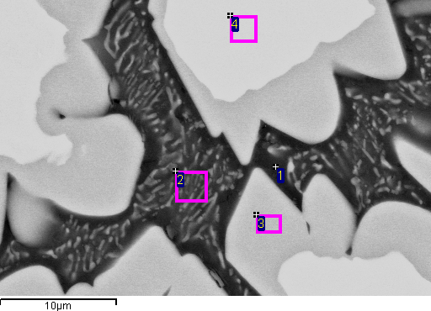

Slide 5
Motivation - 2
The microstructure depends on the cooling rate ranging from
1 to 10⁻⁴ K s⁻¹ in different industrial processes e.g. gas atomization.
IMPRESS FP-6 Project:
Optimize catalytic efficiency of nc-Ni powder production by
variation of process conditions and composition of precursor alloy.
⇒ Thermophysical property measurement in the solid and liquid
phase to provide database for solidification and microstructure
modelling.
⇒ Viscosity and surface tension measurement.

Slide 6
Surface Tension and Viscosity Measurements
Oscillating drop methop:
1-g em-levitation – DLR Cologne
μ-g em-levitation on parabolic and TEXUS sounding rocket flights
– UULM
Oscillating cup method – NPL Teddington

Slide 7
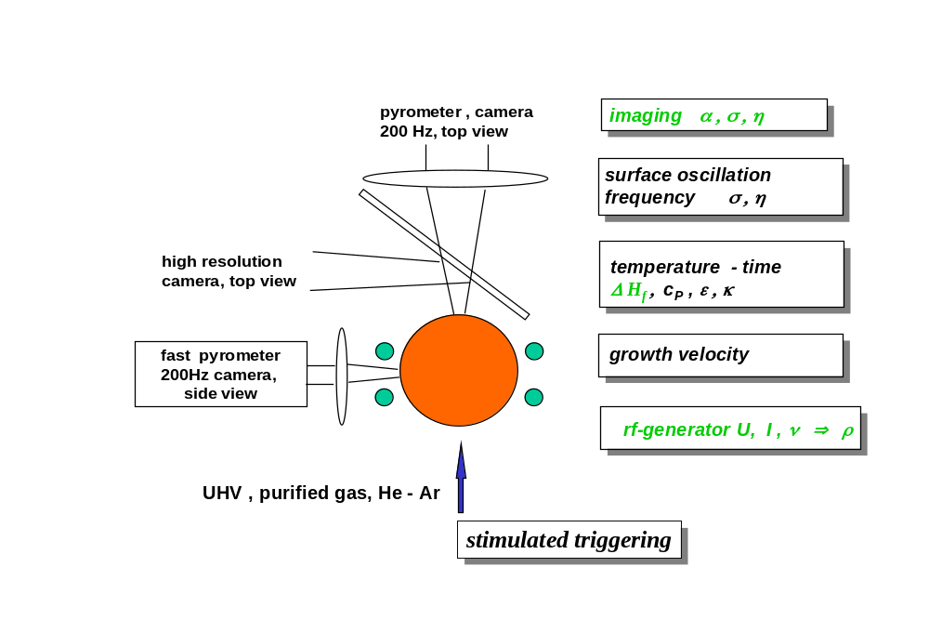
Experimental Aspects
Oscillating drop in an em-levitation device under reduced gravity
Excitation of surface oscillations by pulses of the rf-field during free cooling

Slide 8
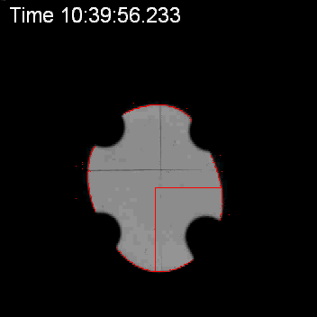
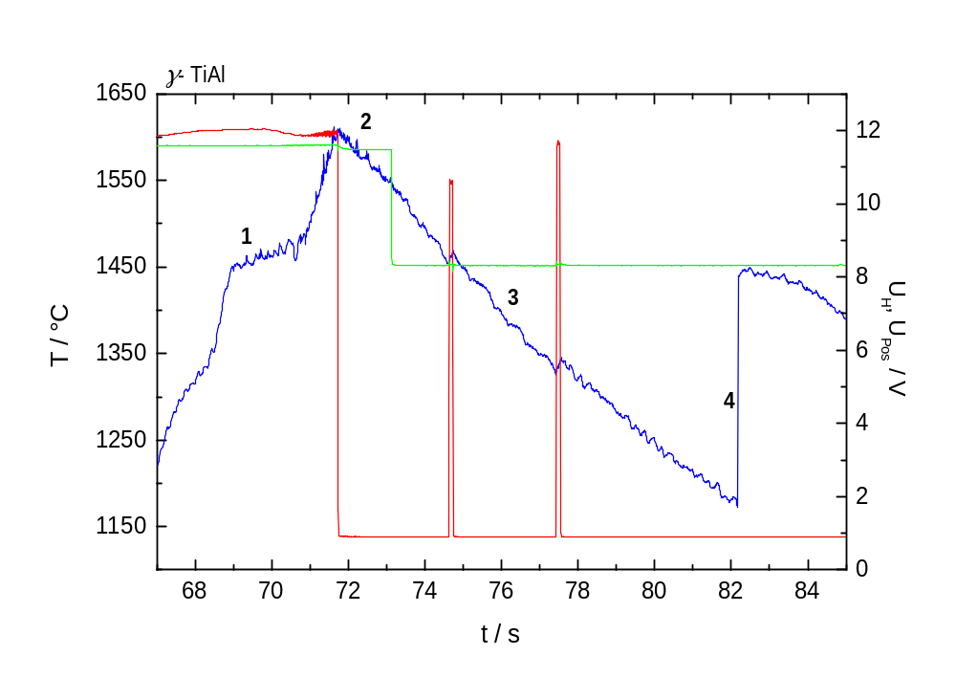
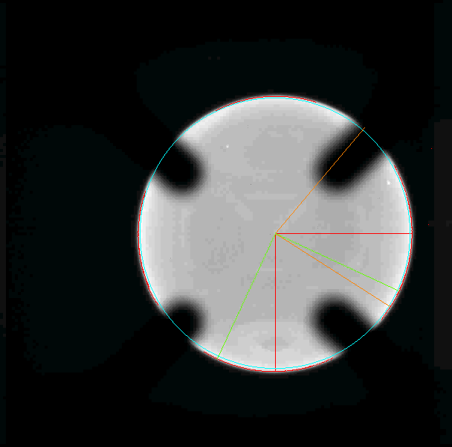
Processing in parabolic flight for surface tension
and viscosity measurement
γ -TiAlNb T_{liq} = 1540 °C
top camera
side camera

Slide 9
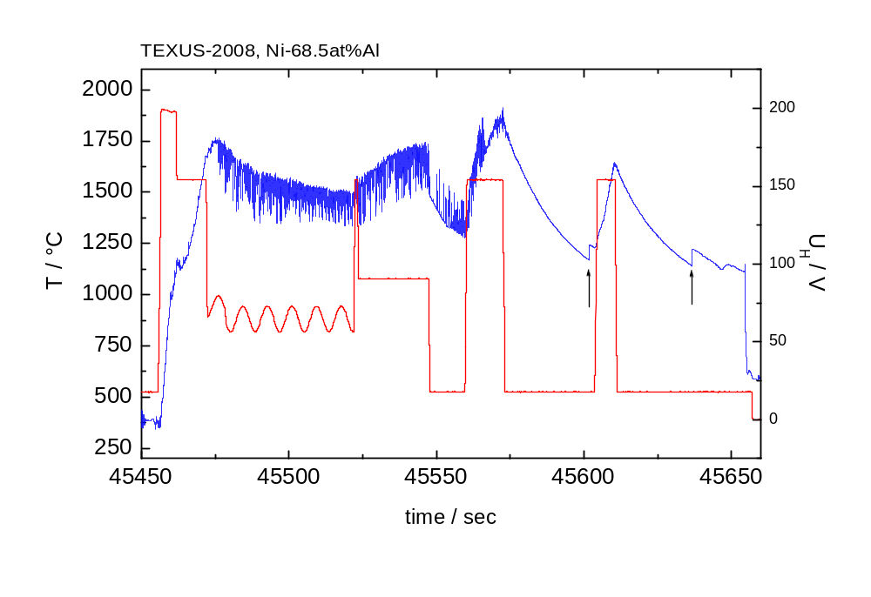
Processing in TEXUS Sounding Rocket
Temperature – Time Profile
Cool 1
Cool 2
Two cooling curves, no pulse excitation

Slide 10
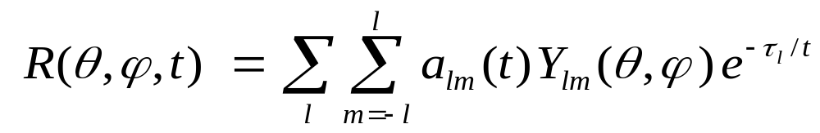
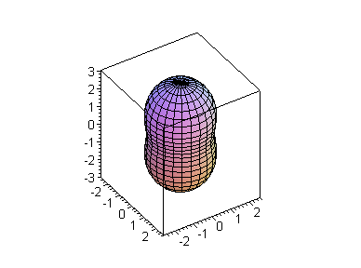
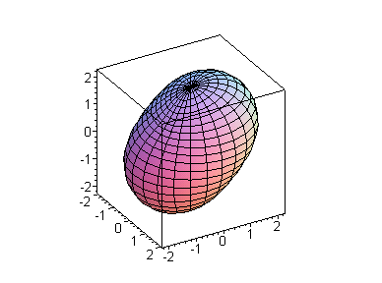
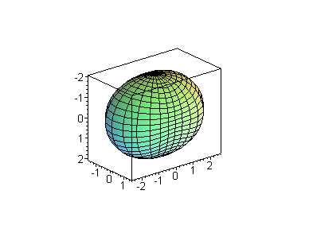
Oscillations of a Liquid Sphere
The Y_{2m}-modes are relevant for practical surface tension
and viscosity measurements; m = 0, ±1, ±2
Y₂₀
Y₂₁
Y₂₂

Slide 11
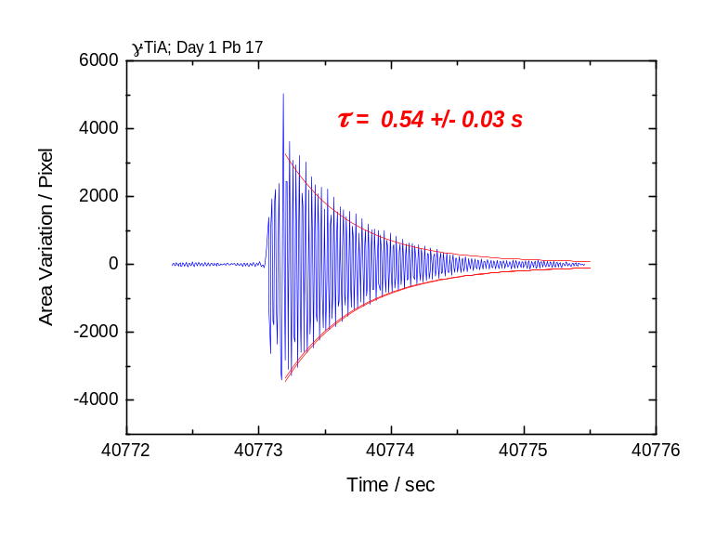
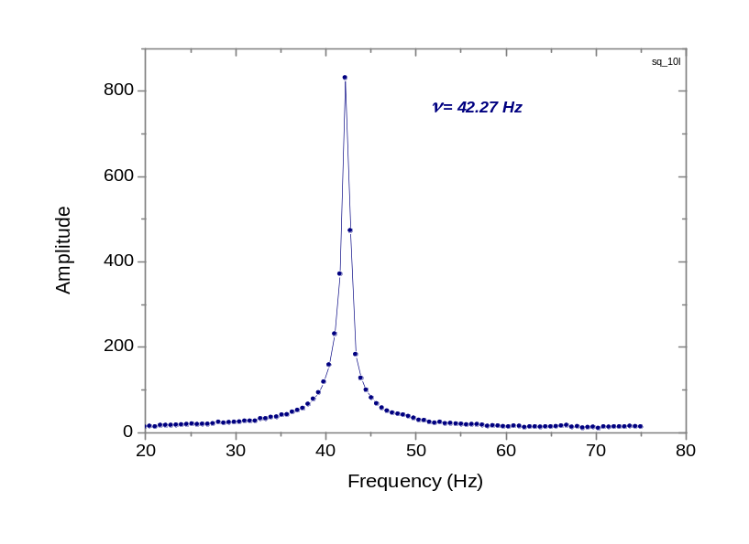
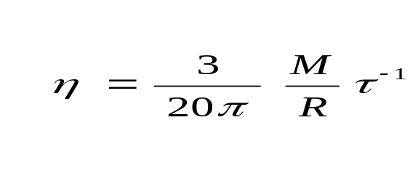
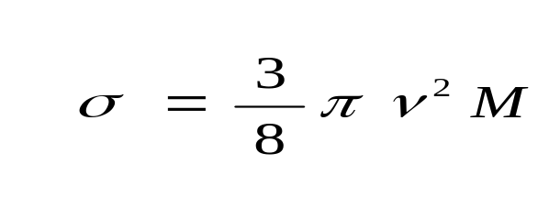
Evaluation of the Viscosity and Surface Tension
Recording of sample shape with 200 Hz digital cameras
Viscosity from damping time constant
Surface tension from frequency

Slide 12
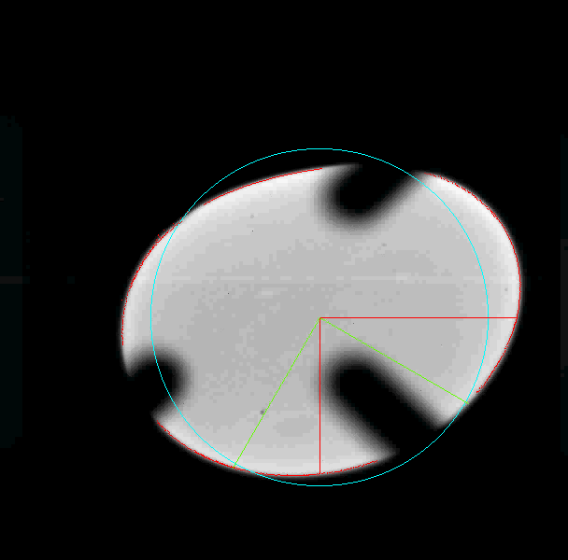
Data Evaluation –
Analysis of Sample Shape Deformation
Measures of Sample Shape Deformation
- Sum & difference of two radii.
- Sum & difference of two rotated radii
- Total area
- Difference area to projected sphere
- Rotated coordinate system, fixed
- Rotated coordinate system, ω_{rot}

Slide 13
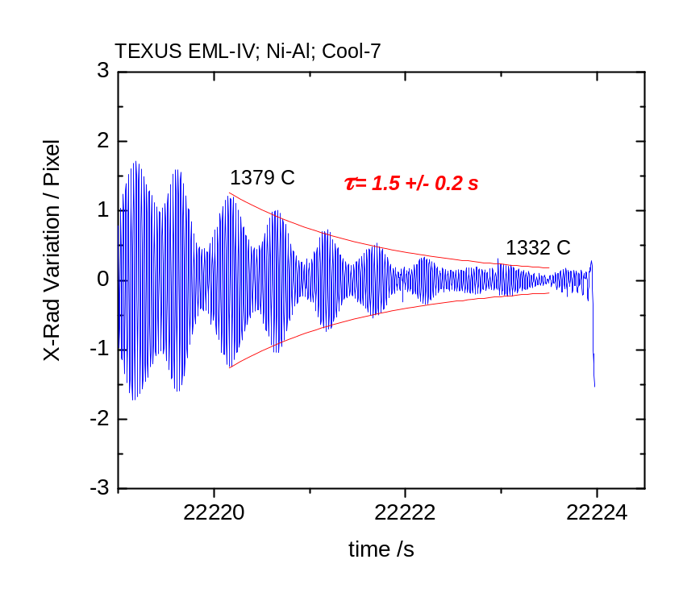
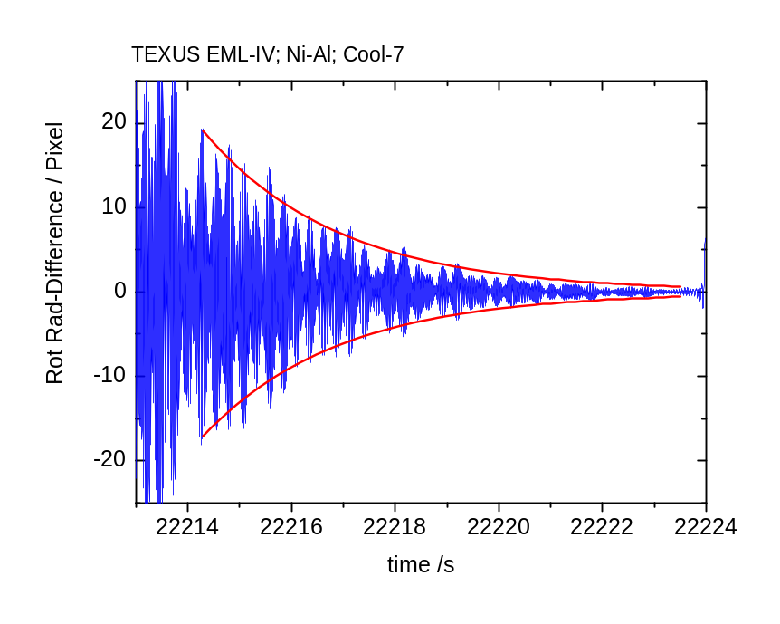
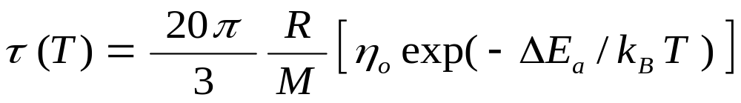
Data Evaluation: TEXUS Sounding Rocket
Radial camera: Radius difference in
Rotated coordinate system ν_{rot} = 10 Hz

Slide 14
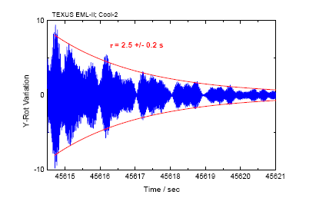
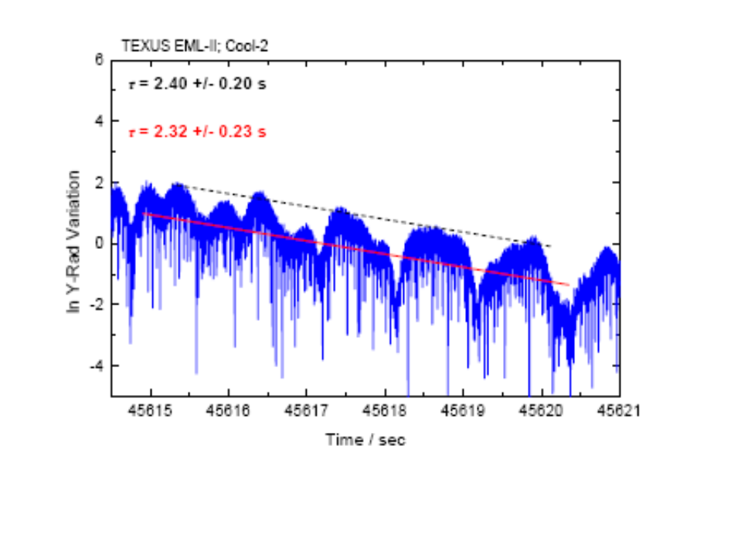
Exponential envelope vs. linear fit to ln of
deformation measure
The linear fit to lnS(t) is very robust in the presence
of a modulated decay. Results agree within ±10%

Slide 15
Results
Surface Tension of Ni-68.5at%A and Ni-75at%Al

Slide 16
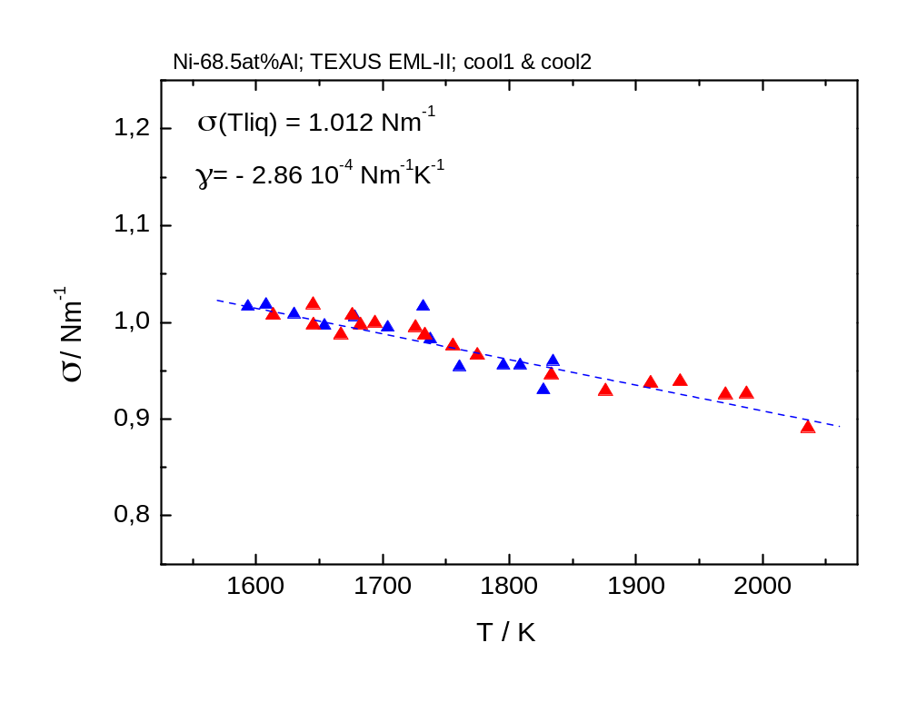
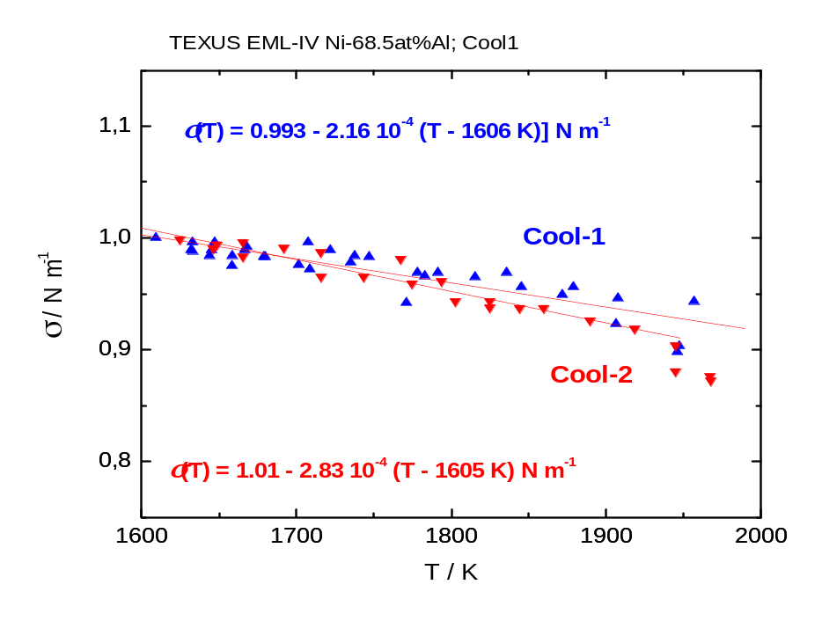
Surface Tension of Ni-68.5at%Al
TEXUS:
PF:
σ (T) = (1.012 ± 0.030) – ( 2.86 ± 0.20 ) 10⁻⁴ ( T − 1332 °C ) Nm⁻¹
σ (T) = ( 0.960 ± 0.012) – (1.62 ± 0.22 ) 10⁻⁴ ( T − 1332 °C ) Nm⁻¹

Slide 17
Summary Results
Surface Tension of Ni-68.5at%Al
Method | Source | σ (T_{liq}) / Nm⁻¹ | dσ / dT / Nm⁻¹K⁻¹
osc. drop | TEXUS – I (av) | 1.012 ± 0.03 | - 2.86 10 ⁻⁴
osc. drop | TEXUS – II (av) | 0.99 ± 0.02 | - 2.32 10 ⁻⁴
osc. drop | PF – (av) | 0.96 ± 0.03 | - 1.62 10 ⁻⁴
osc. drop | 1-g eml | 0.94 ± 0.02 | - 6.9 10 ⁻⁴
Sessile drop | Lab-1 | 0.94 ± 0.02 | - 2.89 10 ⁻⁴
Sessile drop | Lab-2 | 0.94 ± 0.02 | - 2.86 10 ⁻⁴

Slide 18
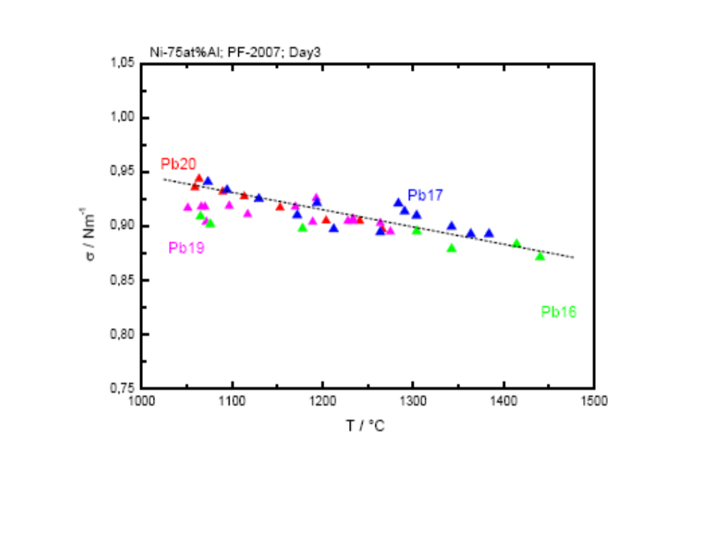
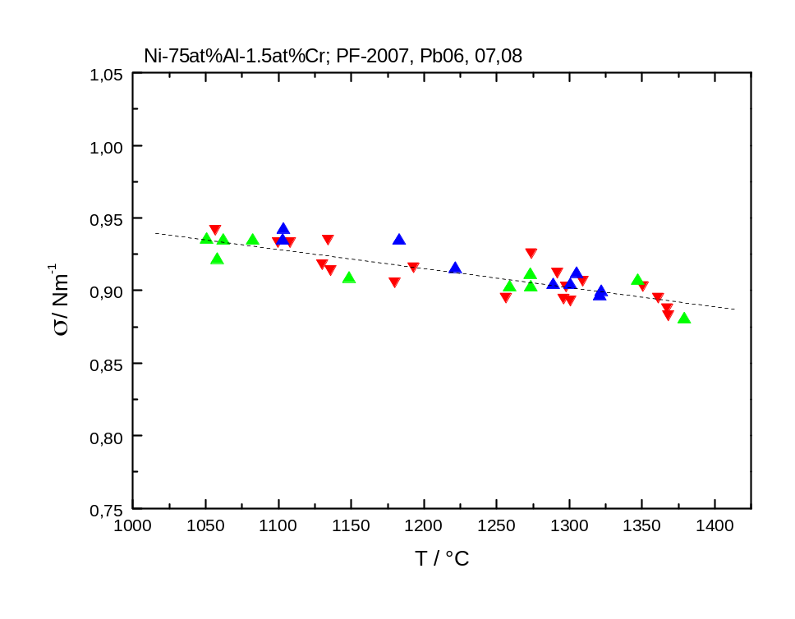
Surface Tension of Ni-75at%Al – (1.5at%Cr)
σ (T ) = ( 0.926 ± 0.006) − (1.40 ± 0.2) 10⁻⁴ ( T − 1398 K ) Nm⁻¹
σ (T ) = ( 0.925 ± 0.006) − (1.38 ± 0.2) 10⁻⁴ ( T − 1398 K ) Nm⁻¹

Slide 19
Summary Results
Surface Tension of Ni-75at%Al
Method | Source | σ (T_{liq}) / Nm⁻¹ | dσ / dT / Nm⁻¹K⁻¹
osc. drop | PF | 0.926 ± 0.03 | - 1.40 10 ⁻⁴
osc. drop | 1-g eml | 0.91 ± 0.02 | - 1.38 10 ⁻⁴
Sessile drop | Lab-1 | 0.936 ± 0.03 | - 1.50 10 ⁻⁴
Verification of the Cummings and Blackburn correction of the
influence of the magnetic field pressure on the surface tension
with < 2% confidence level

Slide 20
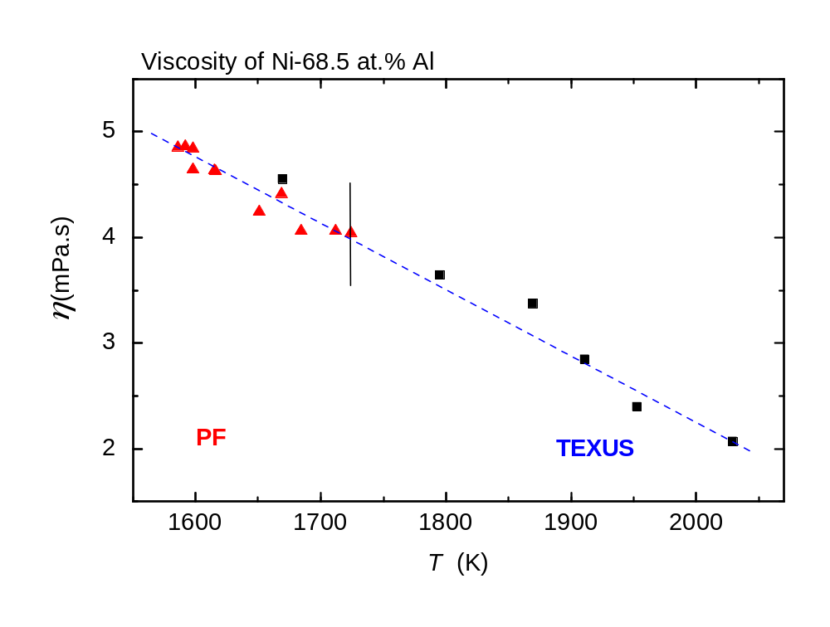
Results:
Viscosity of Ni-68.5at%Al
T_{liq} = 1620 K
TEXUS: η (1670 K) = 4.56 ± 0.24 mPa.s
PF: η (1670 K) = 4.32 ± 0.22 mPa.s
Osc. Cup: η (1670 K) = 4.25 ± 0.22 mPa.s

Slide 21
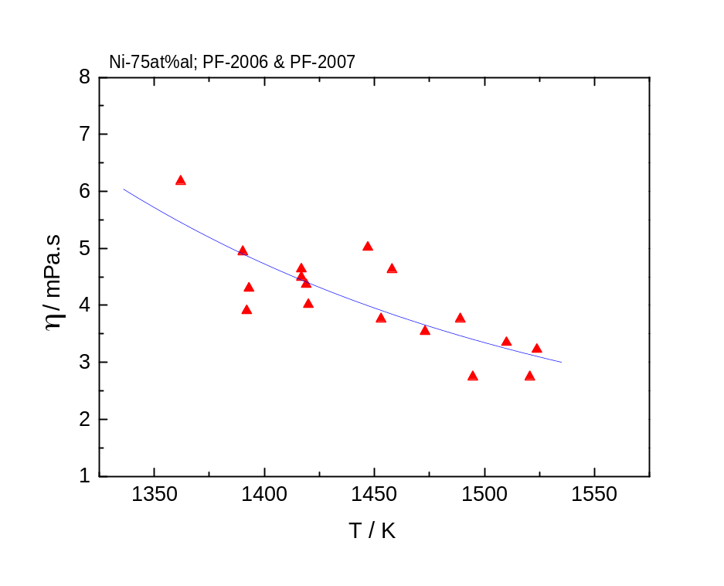
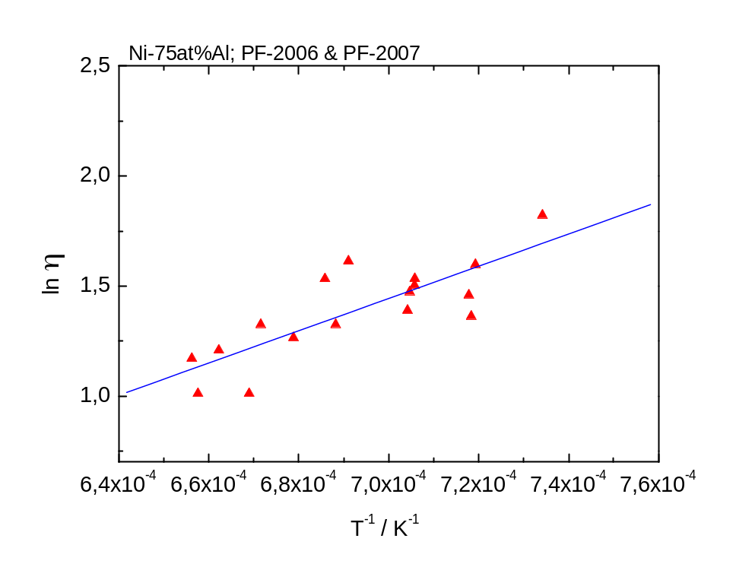
Results:
Viscosity of Ni-75at%Al
T_{liq} = 1398 K
η (T_{liq}) = 4.64 ± 0.24 mPa.s

Slide 22
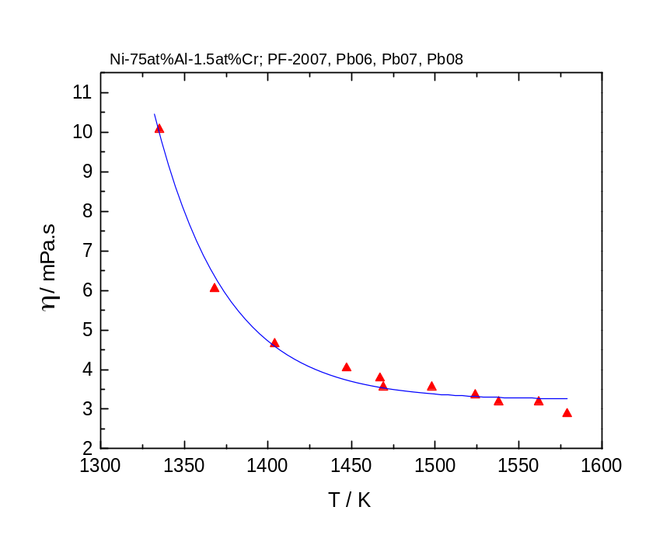
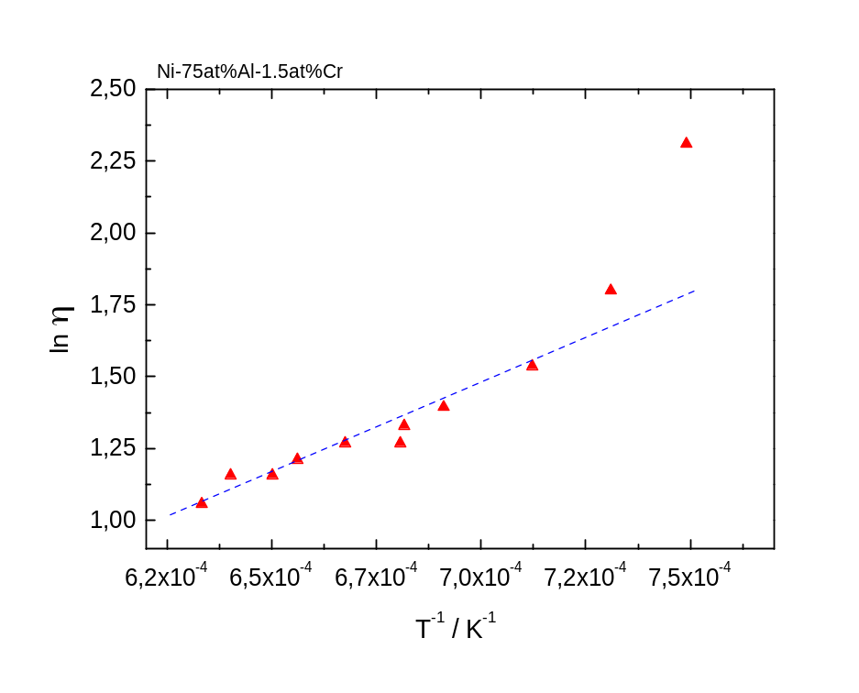
Results:
Viscosity of Ni-75at%Al-1.5at%Cr
η (T_{liq}) = 4.55 ± 0.22 mPa.s

Slide 23
Semiempirical Models of the Viscosity of Alloys
Thermodynamic models:
- Start with ideal mixing
- Correction for interaction in the liquid phase via the heat of
mixing - proper scaling
- Consideration of atomic radii difference
The measured viscosities of Raney-NiAl and Ni-75 at.% Al indicate a non-ideal mixing in the liquid phase with an increase of the viscosity by a factor ≈ 2.3 above the ideal mixing value.
Ni-Al: ΔH_{mix} = − 47 kJ mol-1 at T = 1700 K (50/50)
ΔV_{mix} = −13 % ref to V_{mix} ideal (50/50)
strongly interacting system !

Slide 24
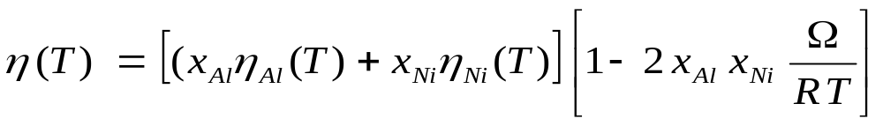
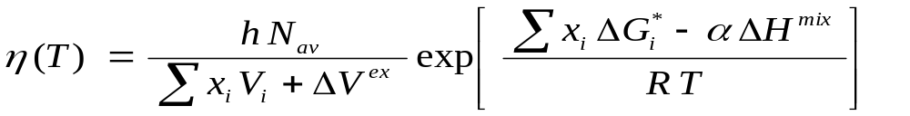
Moelwyn-Hughes model:
Ω: regular solution model interaction parameter
Ω^{exp}(T_{liq}) = − 75 +20/−35 kJ mol⁻¹ from measured viscosity
Ω^{th}(T_{liq}) = − 159 kJ mol⁻¹ from phase diagram calc.
Kaptay model:
ΔV^{ex} from I. Egry et al

Slide 25
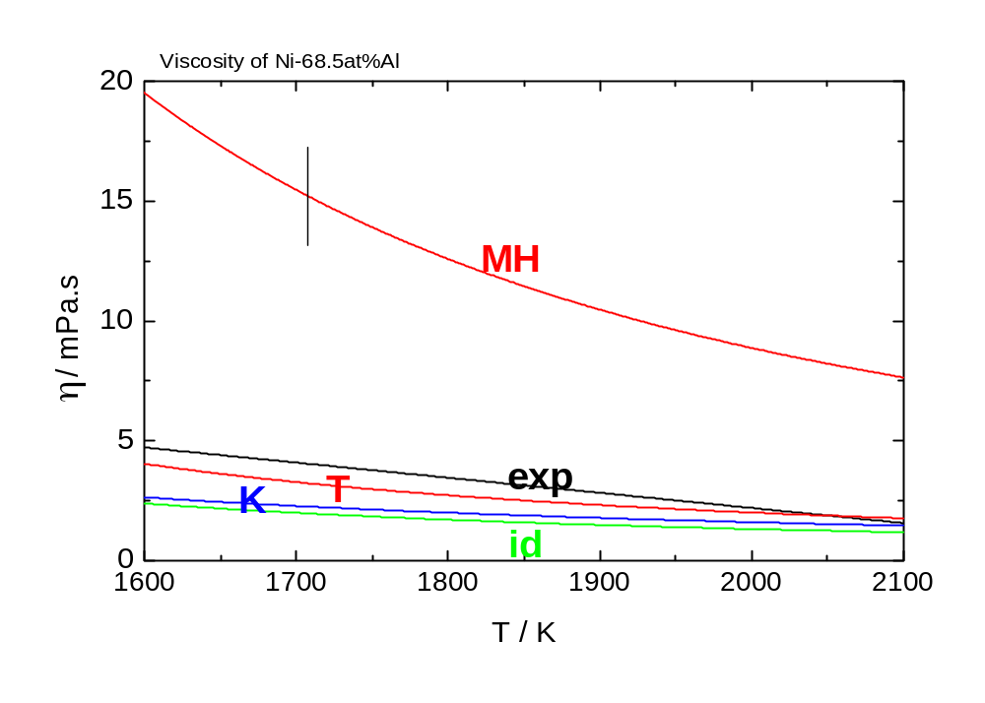
Terzieff model considers:
ΔH_{mix} (+), Δr_{ij} (-), Δm_{ij} (+), ΔV_{ij} (-) / + - contribution to Δη^{exc}
From the 20% increase of the Kaptay model prediction
wrt η ^{id}, 13% are owed to the negative excess volume.

Slide 26
Summary and Conclusions
Surface tension and viscosity of a series of Ni-Al measured by
the oscillating drop method under reduced gravity.
Surface tension: agreement better 3% with results from other
methods / sources.
- Viscosity: when available agreement within +20% of oscillating cup.
Good reproducibility between different μ-g experiments.
Viscosity: agreement within +20 to +40% with values calculated
from different semiempirical models.
- MHD modelling of viscosity measurement by the oscillating
drop needed.

Slide 27
Acknowledgements:
This work was supported by the German Space Agency
DLR contract 50WM5040, by the 6th EC framework project IMPRESS and by the European Space Agency ESA MAP Programme
The excellent support by DLR MUSC in experiment preparation
and conduction and by the teams of EADS Astrium Bremen and Friedrichshafen is gratefully acknowledged.
Prof. I. Egry for many helpful discussions.

Slide 28
End of Presentation
Thank You for Your Attention

Slide 29
TEXUS EML-IV
Ni-68.5at%Al
Results
7 Cooling Curves for Evaluation of Surface Tension and Viscosity

Slide 30
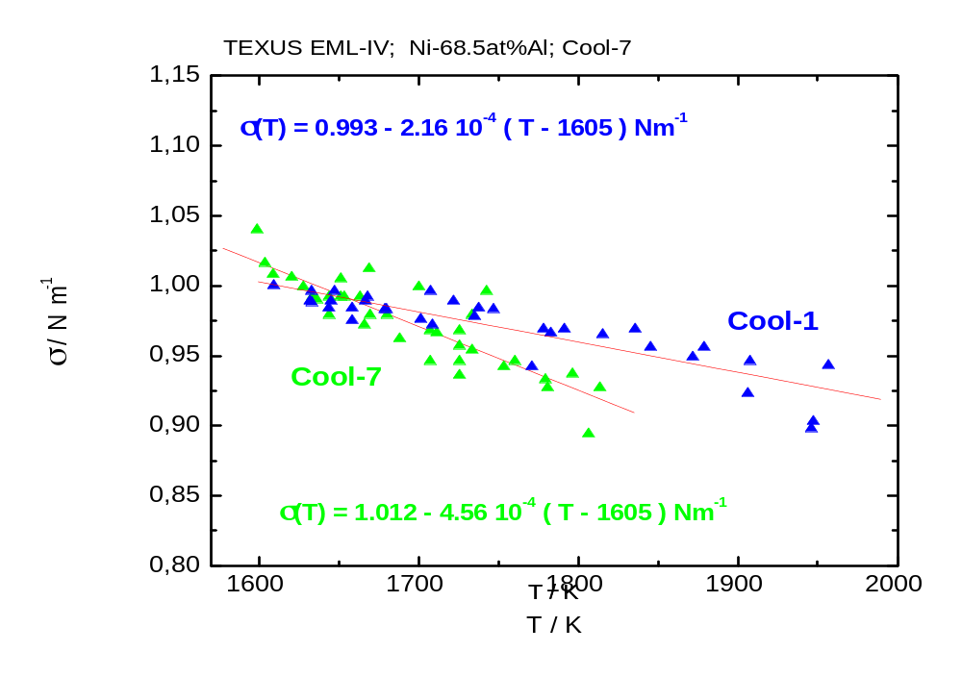
Surface Tension as a Function of Temperature - II
variability of σ(T) between different cooling curves

Slide 31
Summary: Surface Tension Ni-68.5at%Al
 | σ(T_{liq}) / Nm⁻¹ | dσ/dT / Nm⁻¹K⁻¹
Cool-1 | 0.993 ± 0.02 | − 2.16 10⁻⁴
Cool-2 | 1.011 ± 0.02 | − 2.83 10⁻⁴
Cool-3 | 0.978 ± 0.02 | − 1.95 10⁻⁴
Cool-4 | 1.012 ± 0.02 | − 1.24 10⁻⁴
Cool-5 | 0.988 ± 0.02 | − 2.27 10⁻⁴
Cool-6 | 1.015 ± 0.02 | − 1.84 10⁻⁴
Cool-7 | 1.012 ± 0.02 | − 4.56 10⁻⁴

Slide 32
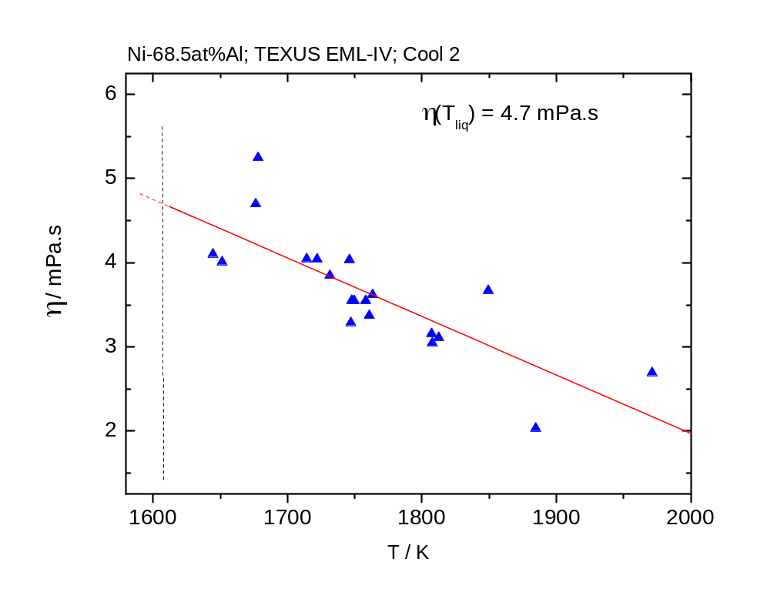
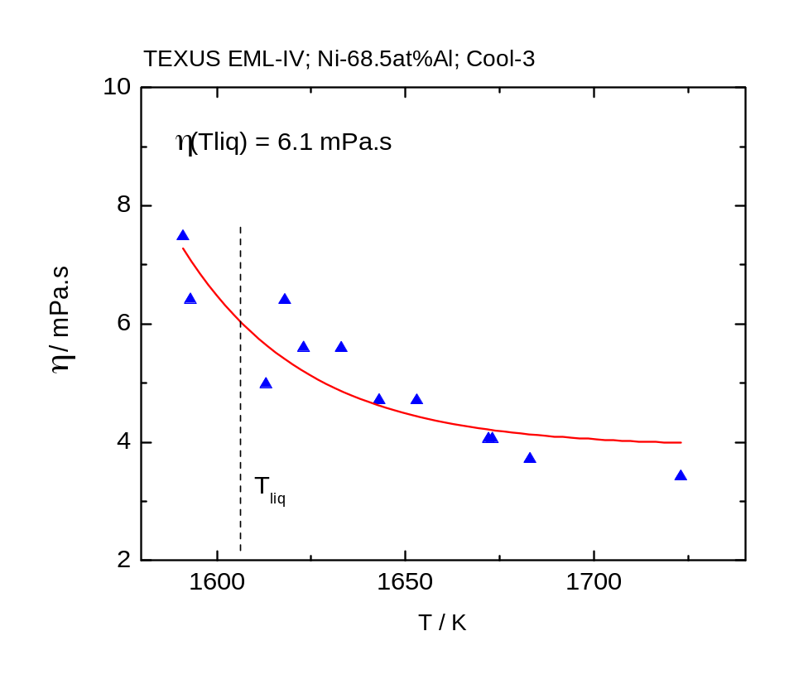
Viscosity Results - I
Cool-2
Cool-3

Slide 33
Summary Viscosity at T = 1670 K
 | Cool-1 | Cool-2 | Cool-3 | Cool-4 | Cool-5 | Cool-6 | Cool-7
η(1670K) | 5.0±0.3 | 4.3 ±0.4 | 4.2 ±0.3 | 3.5 ± 0.2 | 3.8 ± 0.2 | 4.9 ± 0.2 | 4.3 ±0.2
TEXUS EML-II & PF
TEXUS: η (1670 K) = 4.56 ± 0.24 mPa.s
PF: η (1670 K) = 4.24 ± 0.22 mPa.s

Slide 34
Summary
Surface tension:
Results from PF and TEXUS EML-II reproduced.
σ(T_{liq}) all within ± 3%.
Variability of dσ/dT between Cool-1 and Cool-7.
Viscosity:
η(1670K) well reproduced from PF and TEXUS EML-II.
Variation of ΔE_{a} between Cool-1 and Cool-7.

Slide 35
Quality of Data and Data Evaluation

Slide 36
Analytical Capabilities of the TEMPUS
Electromagnetic Levitation Device

Slide 37

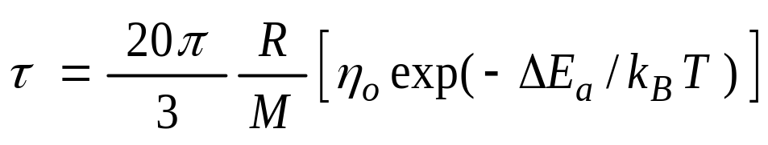
Data Evaluation
Evaluation of τ in certain temperature ranges
2. Calculate η (T_{i})

Slide 38
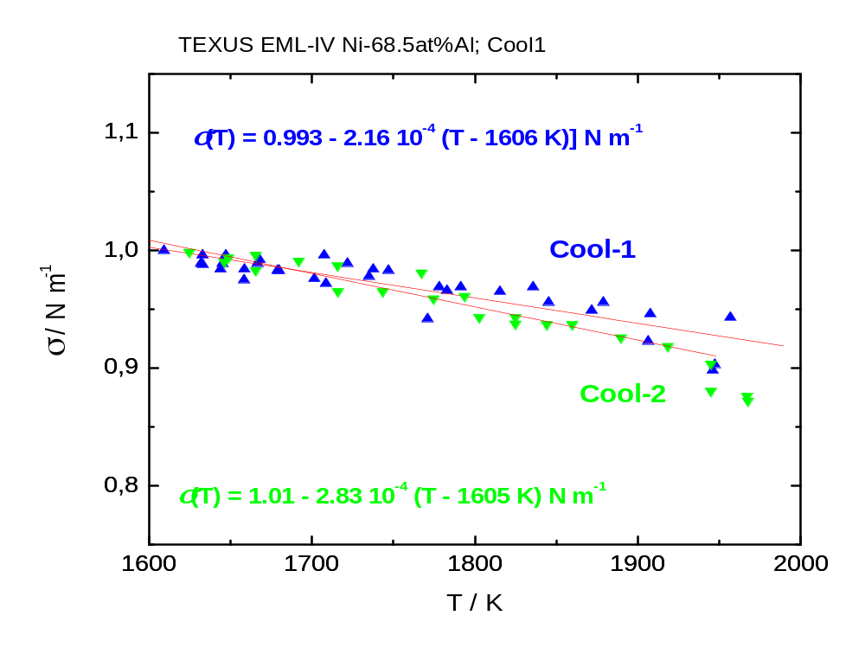
Surface Tension as a Function of Temperature

Slide 39
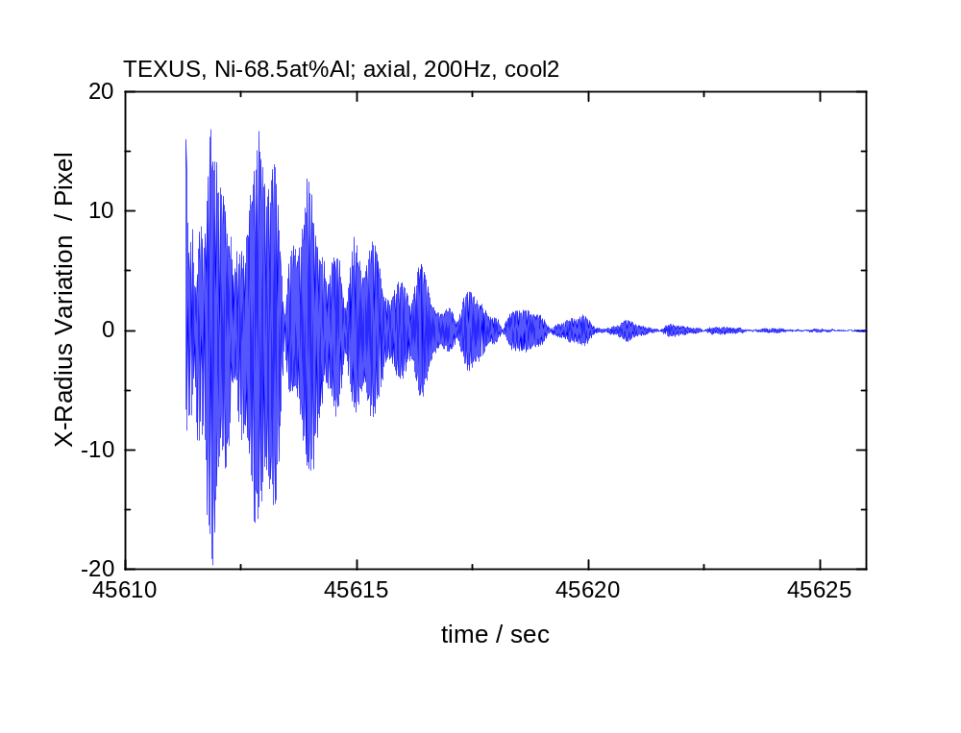
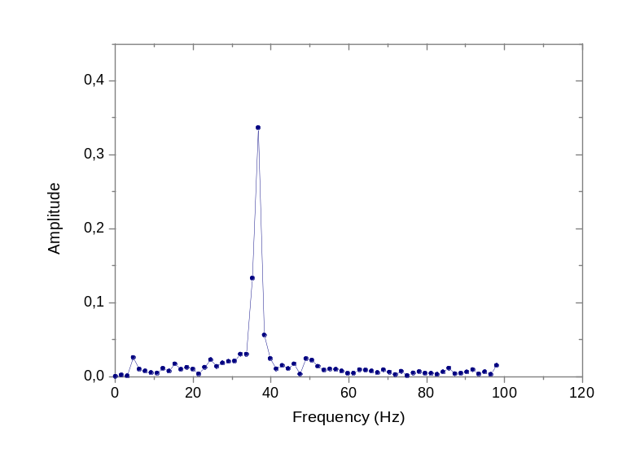
TEXUS EML II:
Surface oscillation spectrum
free surface oscillations

Slide 40
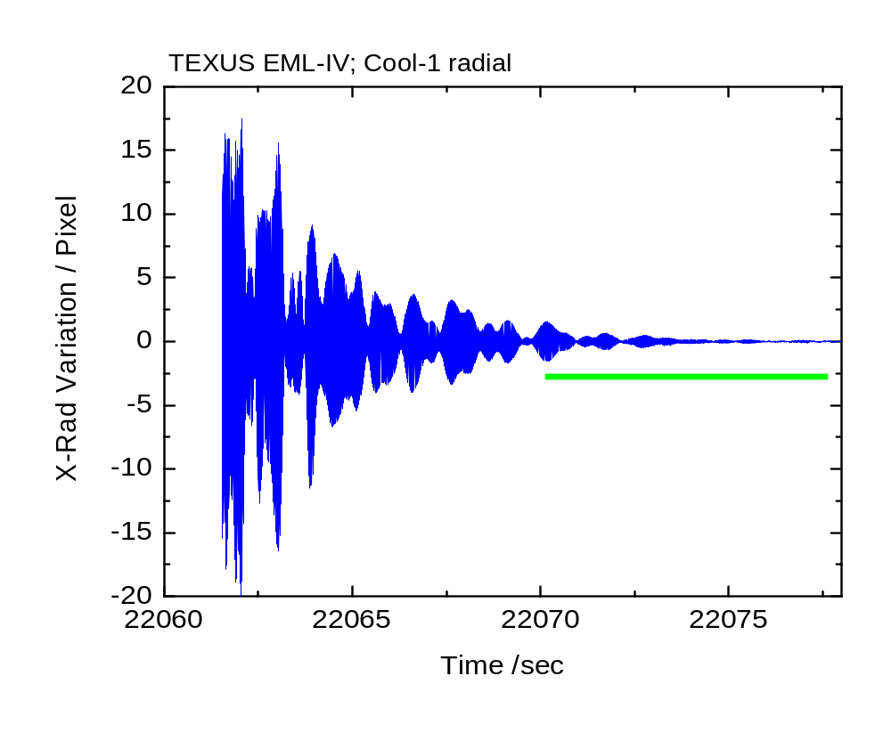
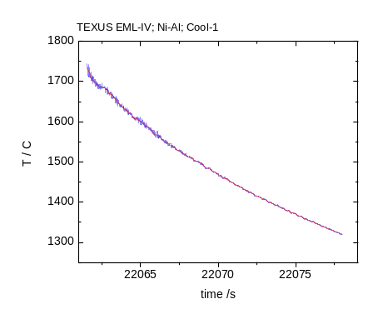
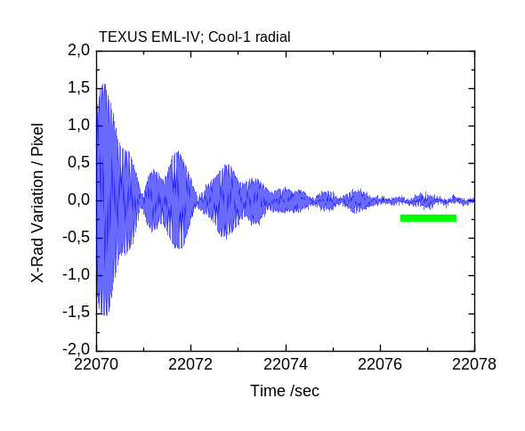
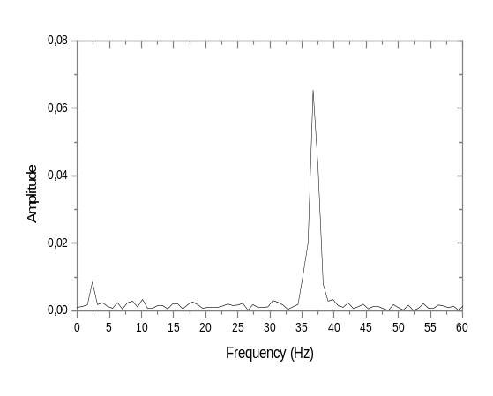
Data Evaluation: TEXUS Sounding Rocket
Rotation & precession present in all cooling curves

Slide 41
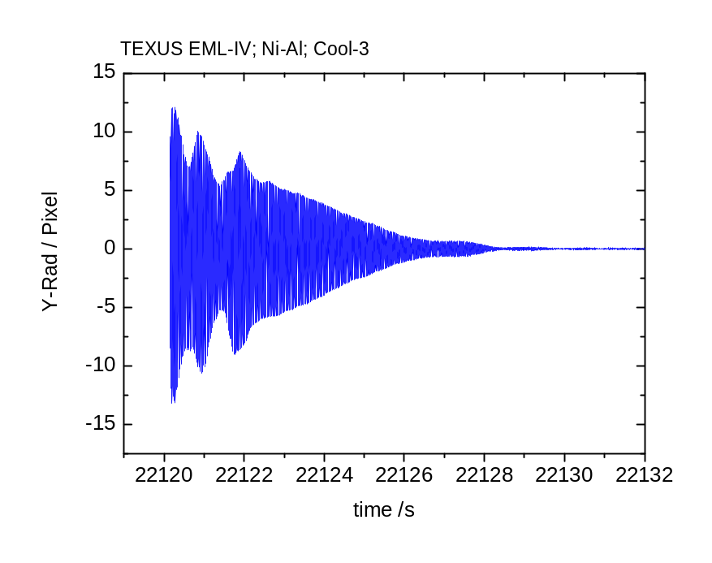
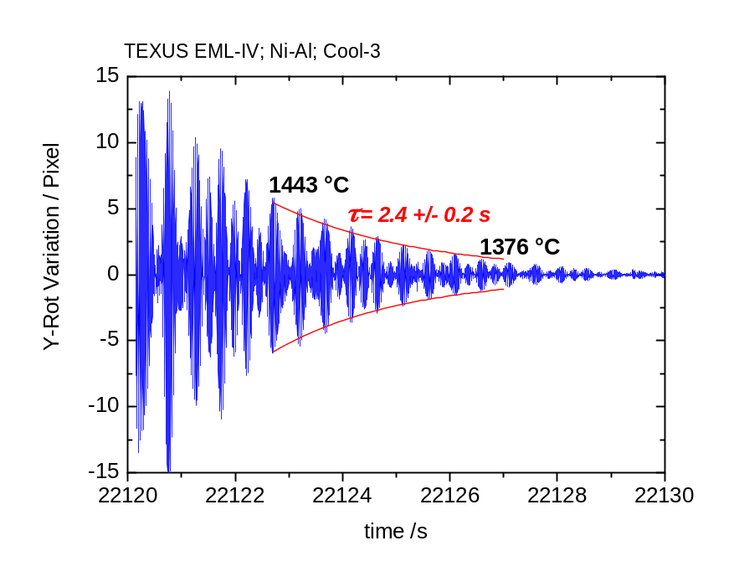
Data Evaluation Cool-3
Y-radius radial camera
Y-radius radial camera.
10 Hz rotating coordinate system

Slide 42
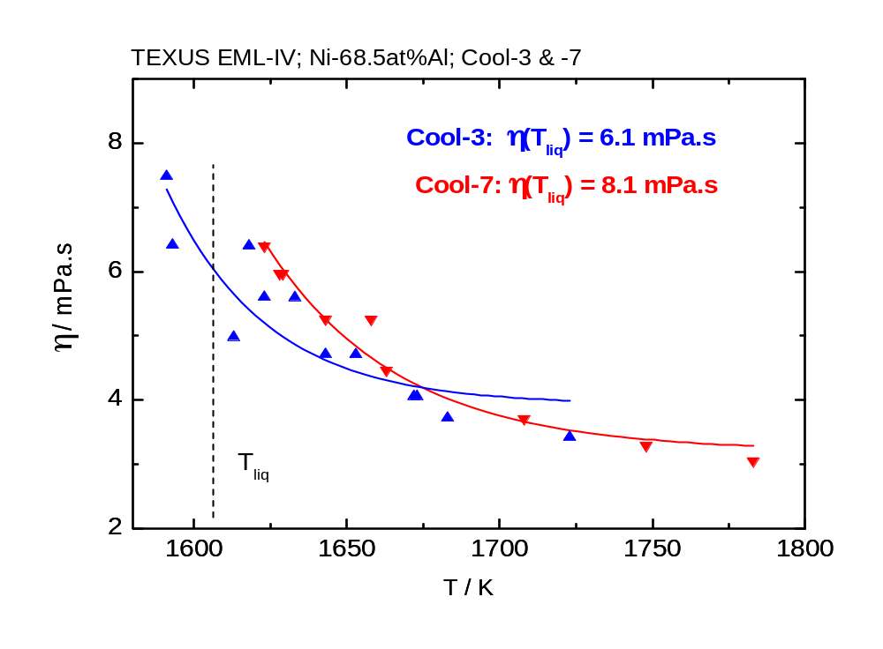
Viscosity Results - II
Cool-3 Cool-7

